Slide 1
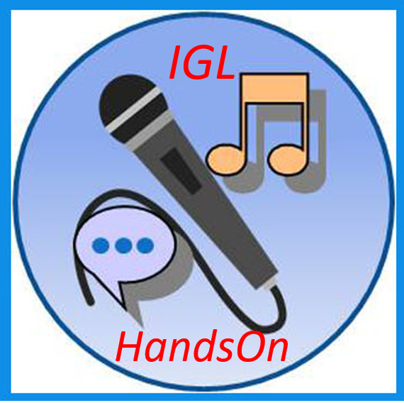
IGL Facebook Chatbot Meera Ganesan Bangalore, India
InstaGana, L.L.C Proprietary and Confidential
1

Slide 2
Project Overview
The IGL Facebook Chatbot project taught us how to develop a Chatbot in developer mode
It can answer FAQs, provide information on past events held in a place (example Dublin), and provide a carousel of 3 videos when a singer’s name is entered by the user
For this, the project used node.js to access the AWS Cloud and Facebook Cloud. All the information about the events were stored in JSON files in AWS Cloud, and the videos were stored in mongo DB in AWS Cloud as well.
InstaGana, L.L.C Proprietary and Confidential
2

Slide 3
What You Learned
I was introduced to Javascript, and got a good hold on the language through the several modules done
I learnt a lot about software development and the various stages it involves.
I was introduced to Facebook Developer, and learnt how to create a Chatbot using it. I also understood the important features of the developer.
I understood how Cloud infrastructure functions, and how JSON files, and mongo DB stored in the AWS cloud are accessed through node.js
Additionally, I learnt how to efficiently plan a project by dividing it into various modules and implementing and testing each of these one at a time before integrating them together.
InstaGana, L.L.C Proprietary and Confidential
3

Slide 4
Feedback/Comments
This project has been a huge learning experience for me and would help me greatly in my future endeavors. I hope to be a part of many more IGL HandsOn projects in the future!
InstaGana, L.L.C Proprietary and Confidential
4

